Slide 1
CLAS 220: Introduction to Classical Mythology
Lecture 2: The Goddesses.
The Homeric Hymns

Slide 2
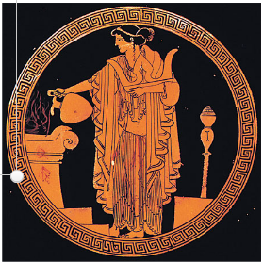
Women in Ancient Greece
status of men and women was far from equal
women usually married shortly after puberty
men married much later
women couldn't own property
if a man had no sons, his daughter would be expected to marry his closest male relative
women did not receive the same education as men
women did not participate as citizens
women rarely left the home, and not without a chaperone
in well-off houses, slaves did most of the work,
wives supervised, did the weaving
exception for religious rituals, priestesses

Slide 3
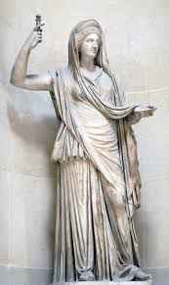
Hera Ἥρα (Roman Juno)
Wife of Zeus (and sister)
Name connected to hôra, season
Marriage, readiness for marriage
Represented seducing her husband
Always seeking vengeance for husband’s infidelities
Frequently antagonistic to the heroes her husband’s mistresses bear
Mother of Ares, Hephaestus, and minor deities
Hebe (youth) and Eileithyia (childbirth)
Worshipped in temples everywhere,
especially Argos

Slide 4
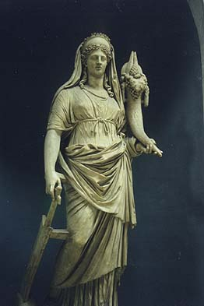
Demeter Δημήτηρ (Roman Ceres)
Name makes her a mother-goddess (mêtêr),
Possibly means “grain-mother”
Goddess of grain and of the harvest
Known for the myth of her daughter, Persephone, (AKA “The Maiden,” Korê), who becomes Queen of the Underworld
Worshipped in secret festivals, like the Eleusinian Mysteries and the Thesmophoria (women-only)

Slide 5
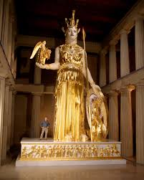
Athena Ἀθηνᾶ (Roman Minerva)
Daughter of Zeus and Mêtis (Cunning), who was foretold to bear a child more powerful than her father;
Zeus swallows Mêtis disguised as a fly, Athena born out of Zeus’ head fully armed
Goddess of the City (especially Athens);
of crafts (weaving, horsemanship),
of the olive tree,
of civilization, of cunning (mêtis)
Virgin Goddess
Especially close to Odysseus

Slide 6
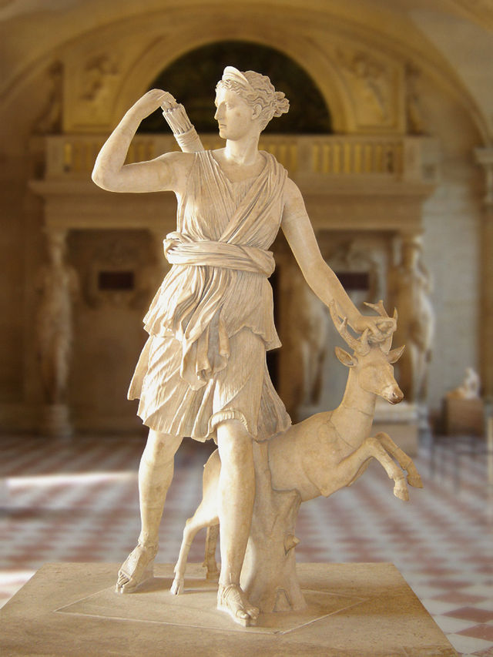
Artemis Ἄρτεμις (Roman Diana)
Twin sister of Apollo
“Mistress of the Animals”, huntress
beautiful young maiden, hunts in the company of nymphs
goddess of sacrifice
sometimes associated with Moon
Moments of initiation in the lives of young women
(menstruation, childbirth)

Slide 7
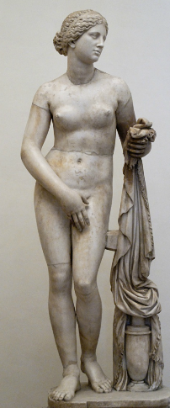
Aphrodite Ἀφροδίτη (Roman Venus)
according to some (Hesiod, Theogony), born in the sea from the severed genitals of Cronus;
according to Homer, Daughter of Zeus
Personifies desire and sexuality, along with her son Eros (Roman Cupid)
Womanly perfection in beauty
Judgement of Paris – contest between Hera, Athena and Aphrodite – Paris pronounces Aphrodite winner
In Homeric Hymn, the mother of Aeneas, who will later become hero of Rome and of Virgil’s Aeneid

Slide 8
Hestia Ἑστία (Roman Vesta)
sister to Zeus, Hera, Poseidon, Hades, Demeter
goddess of the hearth
virgin – the hearth tended by the girls of the house
hearth at Delphi burns eternally for all Greeks
little myth, ritual domestic
sometimes represented as Olympian,
sometimes gives up her place

Slide 9
Homeric Hymns
short poems of praise to the gods, often include prayer
often describe ritual activity
probably began as preludes to performances of Homeric Epic (Iliad, Odyssey)
introduce key features of the god, and often tell an important myth
most important ones may date from Archaic period (i.e. before 500 BC)

Slide 10
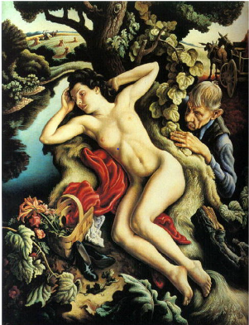
Homeric Hymn to Demeter
THEMES:
1. agricultural cycle
He nodded to Rhea that the girl stay in misty darkness
for one-third share of the revolving year,
but two-thirds with you and other immortals….
Rhea came to the Rarian plain: life-giving udder of land
once fertile, now barren, it stood idle,
stripped of leaves. the land hid the white barley
through graceful Demeter’s cunning. Soon,
with the flourishing spring, the grain would grow
tall again, and in the plain, fat furrows
would be heavy with grain to be tied into sheaves.
(445-7; 450-7)

Slide 11
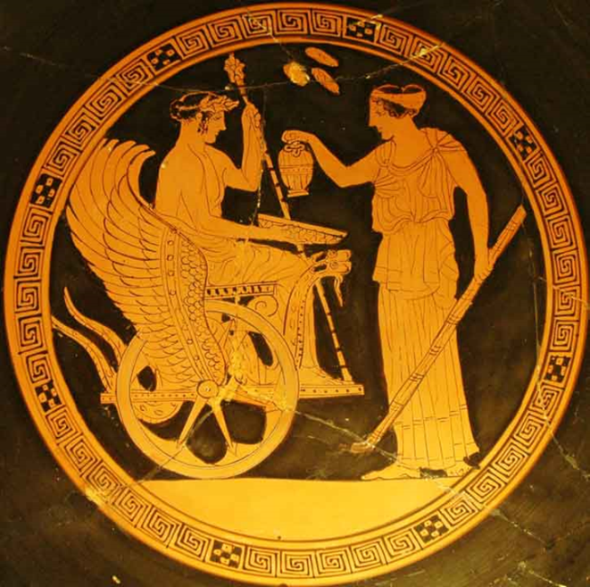
Homeric Hymn to Demeter: Triptolemus
Triptolemus as human to whom Demeter teaches agriculture; “culture hero”
Demeter also teaches him the mysteries
frequently depicted in a winged chariot, sowing seed around the world

Slide 12
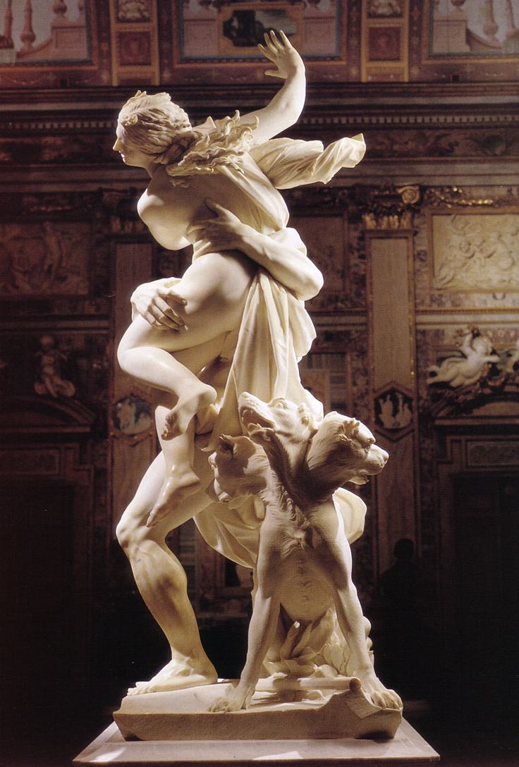
Homeric Hymn to Demeter
THEMES:
2. Marriage (initiation) = death
No other god arranged it but cloud-gathering Zeus,
who gave her to his own brother Hades to be called
his budding wife. He carried her off on his horses
into the misty darkness while she screamed aloud.
But, Goddess, give up your strong grief; let go
of your infinite anger. Hades is not an unsuitable
son-in-law among the gods: Lord of the Many dead,
your own brother from the same seed. As for honor,
he won the third share when the division was made
and lives as king among those in his allotted land.
(78-87)

Slide 13
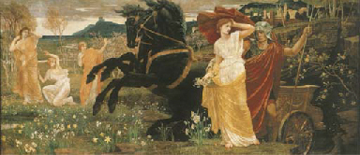
Homeric Hymn to Demeter : Marriage and Death
Persephone also called Kore, “the maiden”
at the beginning of the poem, she’s gathering flowers in a field with her girlfriends
girlhood friendships vs. marriage
agriculture vs. gathering
marriage hymns as laments
marriage destroys one family as it creates another

Slide 14
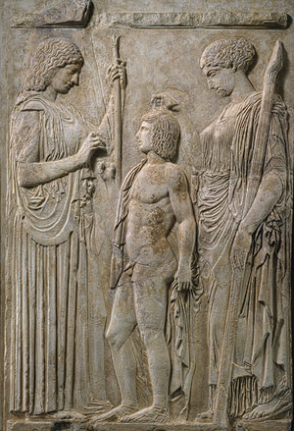
Homeric Hymn to Demeter
THEMES: 3. Mysteries and Ritual
She made that a most dreadful and bitter year
for people on the land that feeds them, and the earth
sprouted no seed: Demeter, richly crowned, concealed it.
Oxen dragged the curved plows in vain through fields
and the white barley fell fruitless to the earth.
The cruel famine would have destroyed the whole race
of speaking folk, and deprived those in Olympos
of the splendid honor of gifts and sacrifices,
had Zeus not noticed, and devised a plan. (305-13)
Demeter revealed her sacred rites
to the kings who give justice, to Triptolemos,…
sacred things not to be transgressed, asked about,
or uttered, great awe of the gods stops the voice.
Blest are the earth-bound mortals who have seen these rites,
but the uninitiate, who has no share in them,
never has the same lot when dead in misty darkness. (473-82)

Slide 15
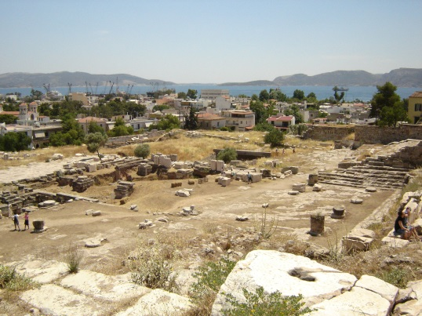
Homeric Hymn to Demeter : Eleusinian Mysteries
remain somewhat mysterious; ancient sources kept the mysteries – mysterious
Homeric Hymn to Demeter provides founding myth; significant that Demeter teaches Triptolemus how to grow grain
Mentions in other ancient authors
More details in some early Christian writers, but hostile
Those who wanted to be initiated had to speak Greek and could not have shed blood
Two levels of initiation
Nine days of ritual in late September
Procession from Eleusis to Athens
Each initiate sacrifices a piglet by the sea
Procession back to Eleusis carrying statue of boy-god Iacchus
Perhaps “sacred marriage” between priest and priestess

Slide 16
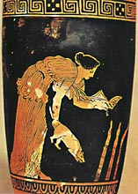
Homeric Hymn to Demeter : Thesmophoria
another secret agricultural festival
held in October
women-only
three days
day of procession
day of fasting
day of piglet sacrifice; retrieval of last years’ sacrificial victims from snaky pit

Slide 17
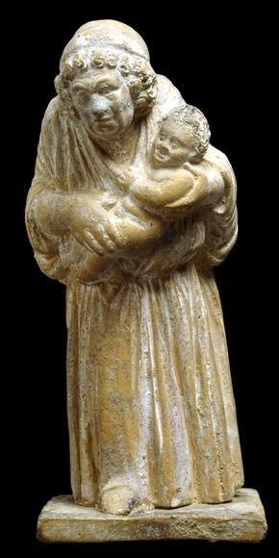
Homeric Hymn to Demeter : Demophon
While grieving for her own daughter, Demeter disguises herself as old woman
King Celeus of Eleusis hires her to be a nurse for his son Demophon
The disguised Demeter tries to make Demophon immortal by feeding him ambrosia and hiding him in the fire every night
then one night Demophon’s mother, Metaneira, catches her “burning” the baby, and freaks out
as a result, Demophon cannot be immortal, but he will get kleos and an annual mock-battle festival
parallels with Persephone

Slide 18
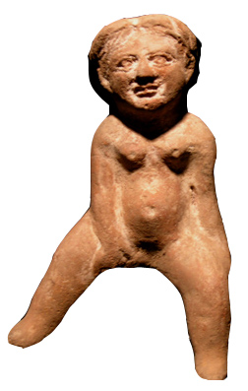
Homeric Hymn to Demeter : Iambe
She sat, wasting with longing for her daughter,
until wise, careful, Iambe jested with her.
With a slew of jokes, Iambe made the divine lady
smile, laugh, and keep a gracious mood –
Iambe who in later times also pleased her spirit.
201-05

Slide 19
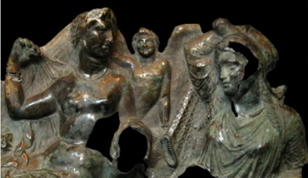
Homeric Hymn to Aphrodite
Casting sweet desire into Aphrodite’s own heart,
Zeus made her long for a human man, so that
even smile-loving Aphrodite herself could not keep out
of a mortal man’s bed. Then she could not tell –
boasting among all the gods, laughing sweetly –
how she made the gods mate with mortal women
(who bore mortal sons to immortal fathers)
Zeus cast sweet desire in her heart for Anchises –
his body like a god’s – who often tended cattle
in the high mountains of Ida, rich in springs. (45-55)

Slide 20
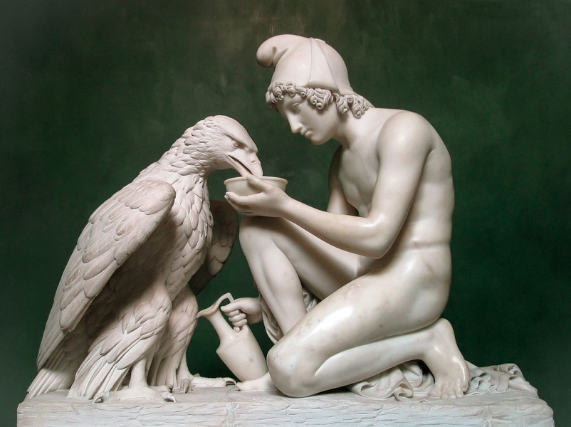
Homeric Hymn to Aphrodite: The example of Ganymede
Wise Zeus seized Ganymede for his blond beauty,
Now he lives among the immortal gods
and pours wine for them in Zeus’ house –
amazing, a man honoured by all the immortals,
drawing the red nectar from a gold mixing bowl.
But unrelenting sorrow held father Tros: he did not know
where the divine whirlwind had taken his dear son.
Every day, he grieved without end for his son.
At last, Zeus had pity on him: in payment for his son
he gave him spirited horses, the kind gods ride…
202-11

Slide 21
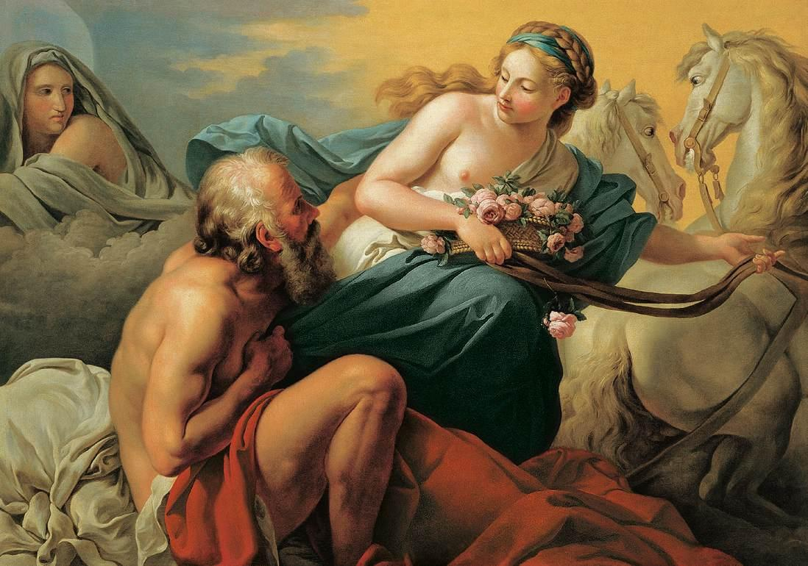
Homeric Hymn to Aphrodite: The example of Tithonus
yet another Trojan prince
Eos, the goddess of the dawn, falls in love with him
she begs Zeus for eternal life for him
forgets to ask for eternal youth
he just keeps getting older
in some versions (not here) he becomes a grasshopper
his son, Memnon, becomes one of Achilles’ rivals
after the end of the Iliad

Slide 22
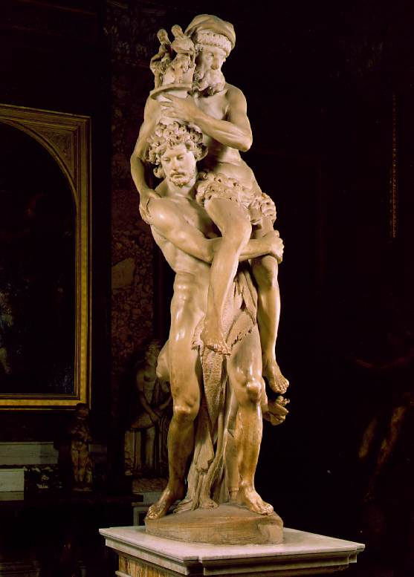
Homeric Hymn to Aphrodite: Anchises and Rome
Homeric Hymn to Aphrodite tells us that Anchises and Aphrodite will have a son who rules among Trojans
but the Homeric epic tradition leaves no room for kings of Troy after the Trojan War
the Romans insert themselves into this gap, and have Anchises’ son Aeneas flee Troy
– and head to Italy, where he will found what will become Rome in Virgil’s Aeneid

